Slide 1


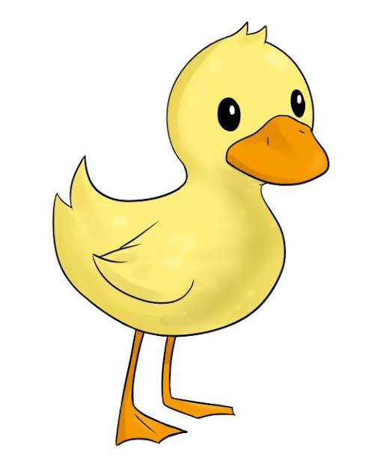
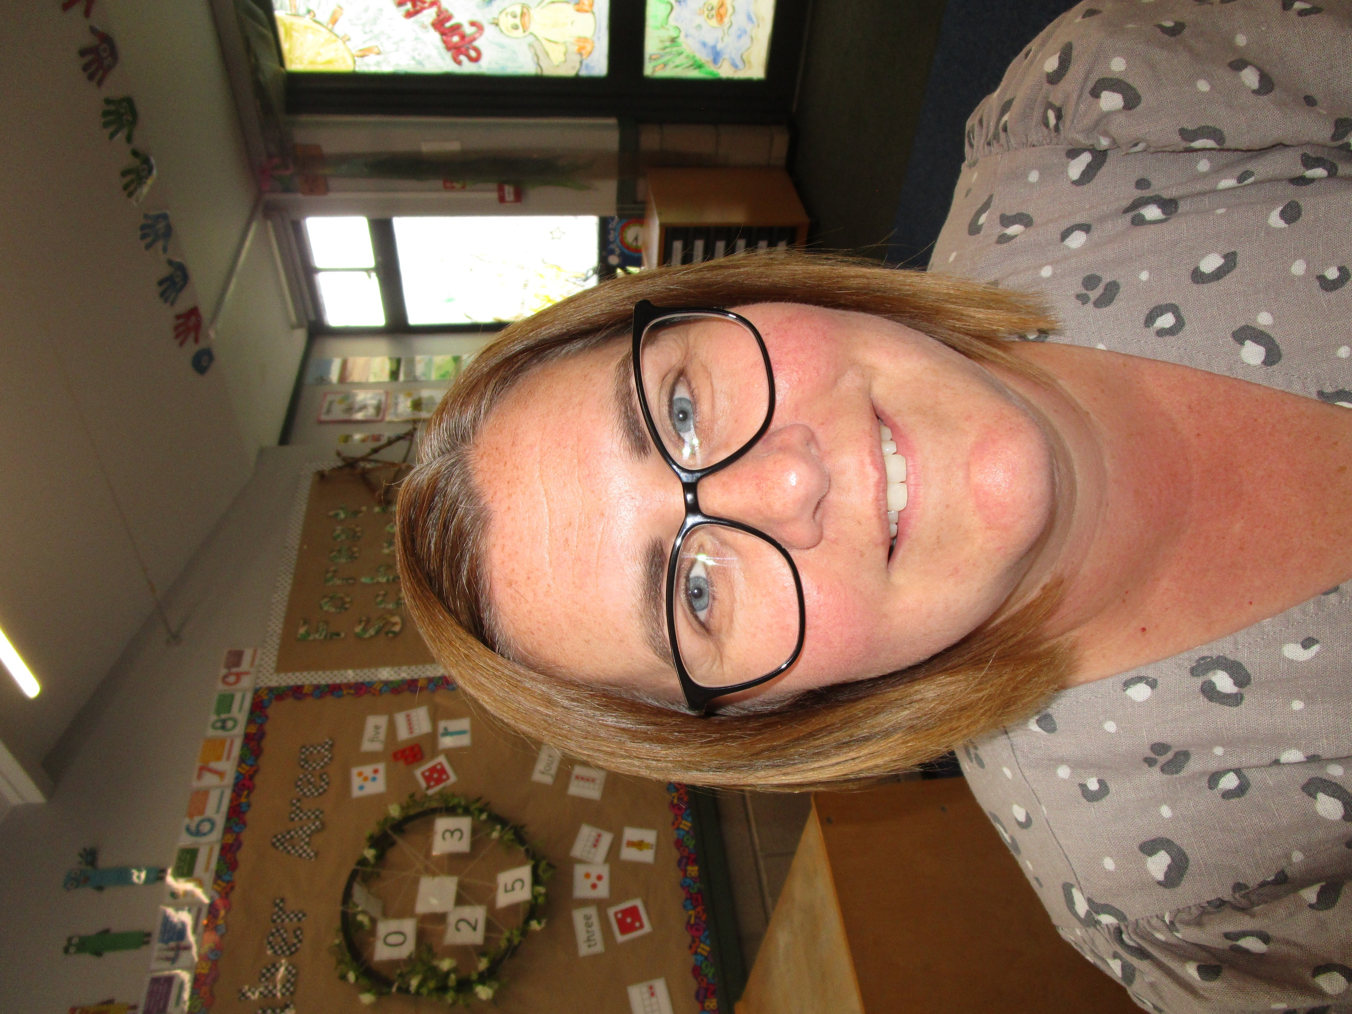
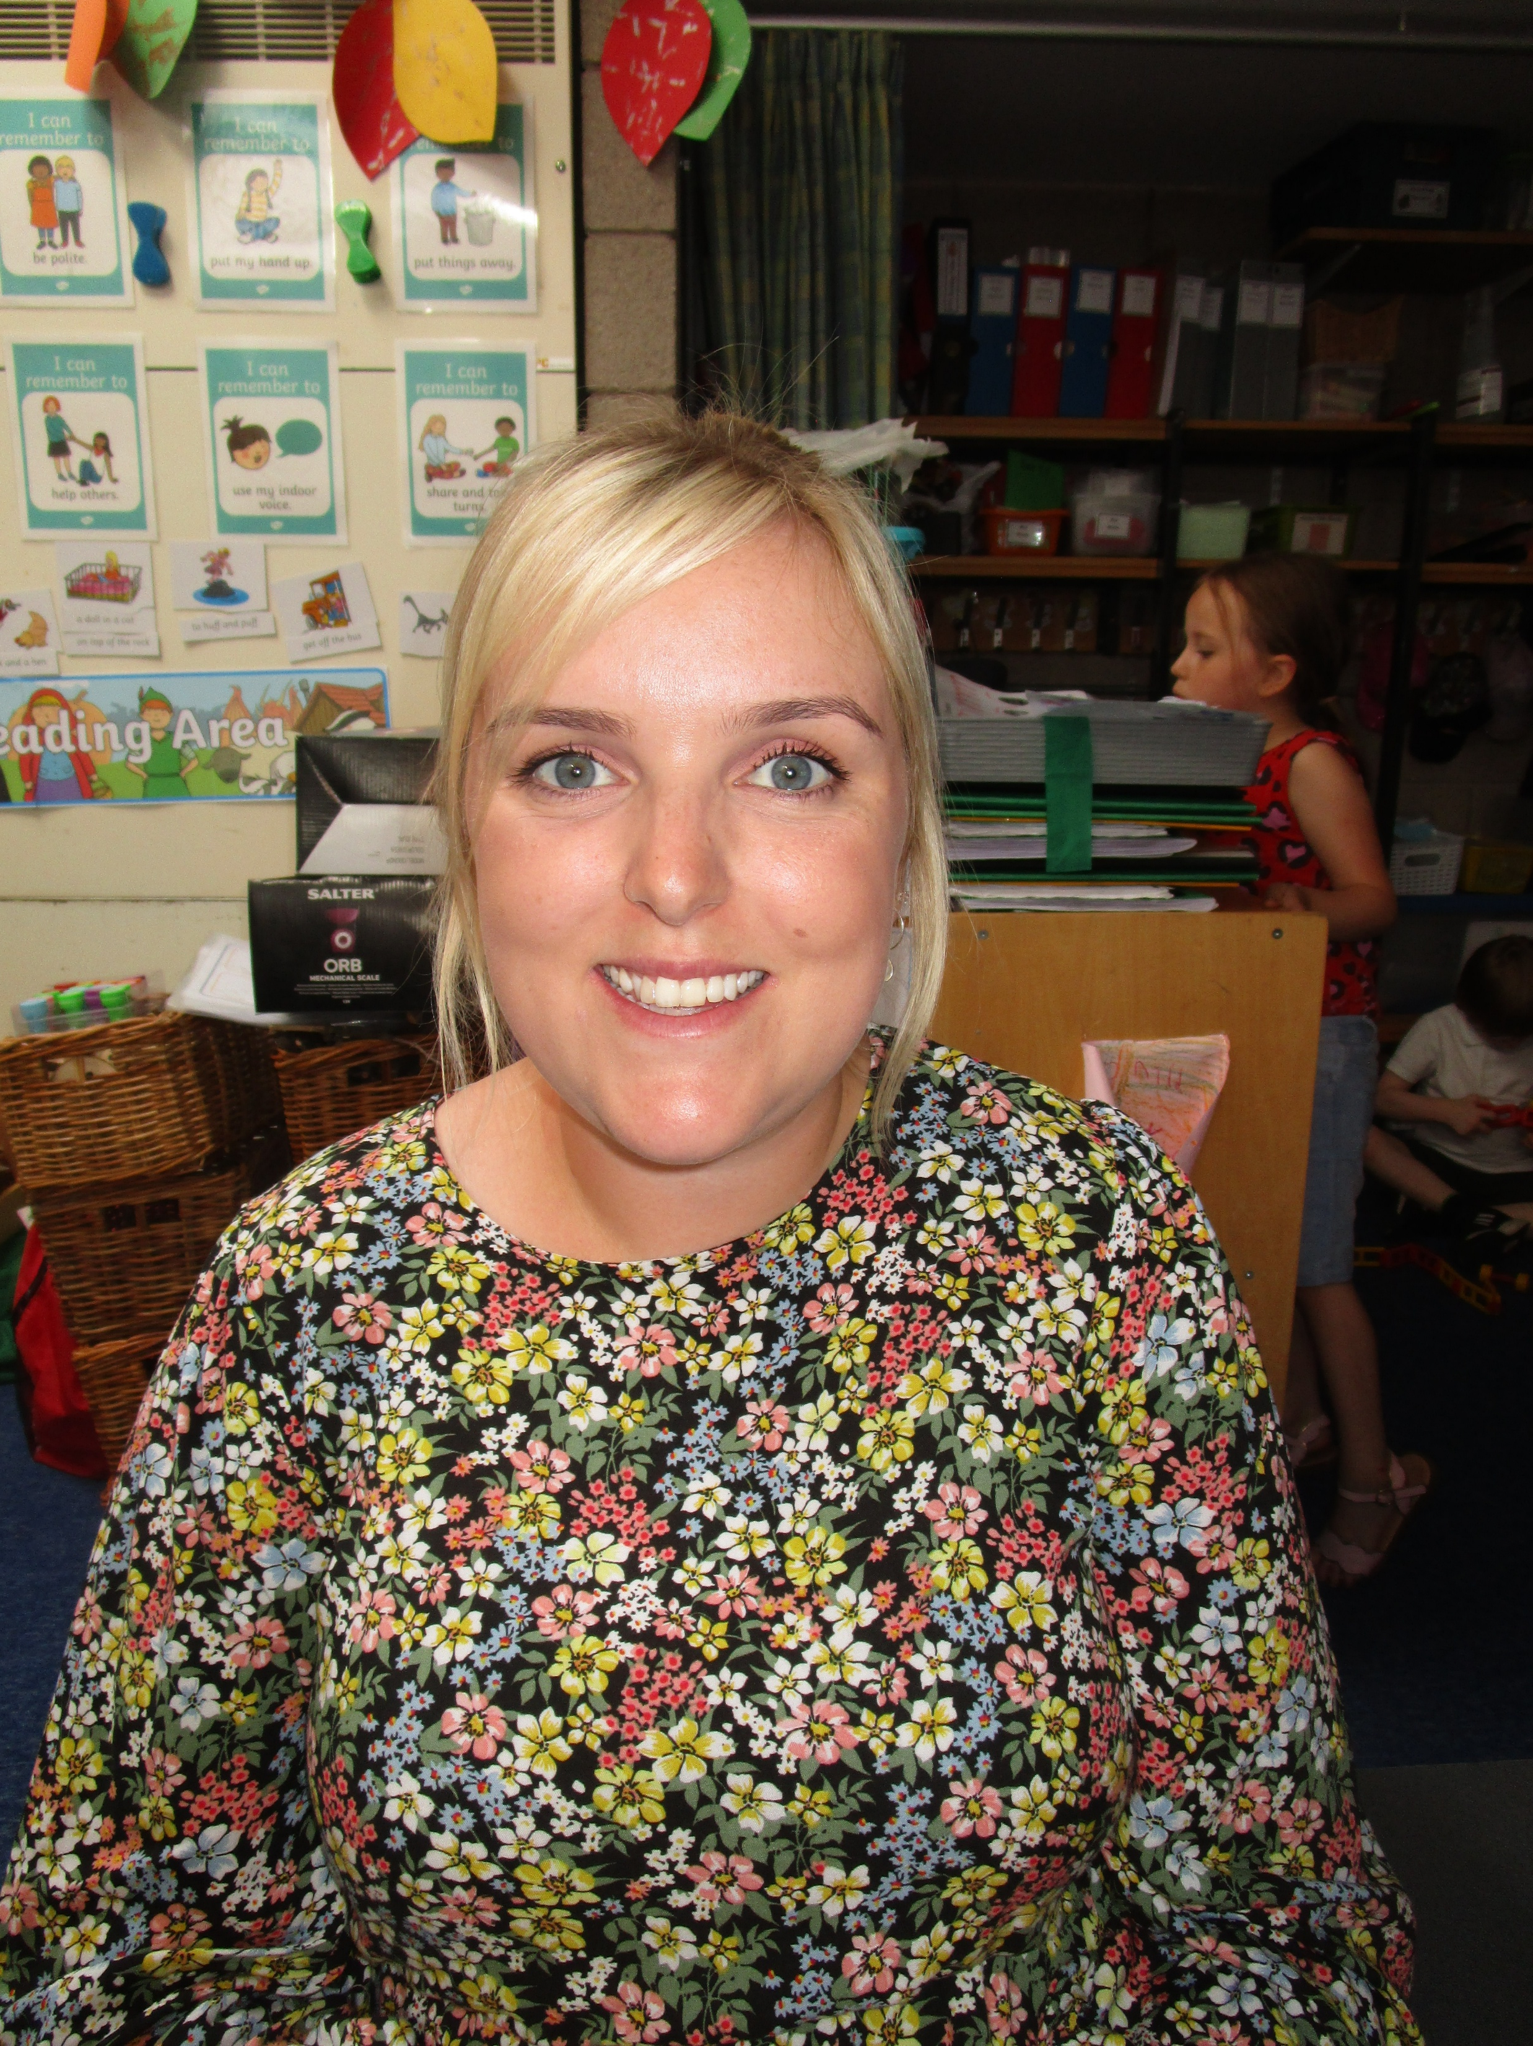
Welcome to
Ducklings
Year - Reception
2026-27
Your teacher is Mrs Woodfine
Your Teaching Assistant is Miss Langley

Slide 2
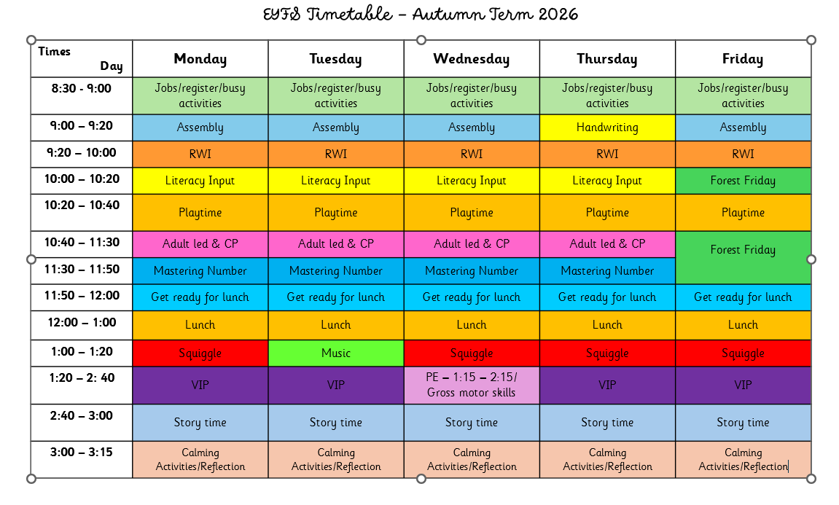
This booklet is to help provide useful information to parents and carers about our class routines so that you can help your child settle into their new class as smoothly as possible.
Class Weekly Timetable
Other Useful Information
Reading & Library Books | Monday will be the day that all children get to change their books each week. It will just be library books initially. All books are issued in plastic wallets. Please ensure books (in their plastic wallet) are in school each Monday—thank you. Once we start reading they will need to bring in their Reading Jungle Journal too .
PE | The children will need to arrive at school wearing their PE kit on Wednesdays. They will need to wear: navy shorts, white t-shirt, white socks and trainers. They can wear their school cardigan or jumper. They are welcome to wear navy joggers over the top of their shorts during the colder months.
Home learning | We will send letter sounds linked to RWI home on Thursdays after the sounds have been learnt for that week. When we start we will send home a little pouch for sounds to be kept in. We will also send home red words each term. Other activities maybe sent at different times, this maybe via Tapestry.
Forest School | On Friday children are to come to school in Forest clothes ready to work outside. Please make sure children have enough layers to put on if it is cold. Wellies and waterproofs need to be in a labelled bag as we have assembly before forest school.

Slide 3
Home Learning Tasks
It is our school policy to provide the opportunity for children to undertake regular, age-appropriate activities at home that support and help to consolidate the children’s learning in school.
Research has shown that children make better progress in school when parents and carers are involved and interested in their child’s learning.
Suggested time per day | Approximately 10 - 15 minutes per night
Regular daily activities | Practising Read, Write, Inc sounds Reading to an adult (please tick and sign Jungle Reading Journal each time your child reads with you) Practising red/tricky words
Other home learning activities | Sharing library books. We will sometime set other activities that can be done at home, these will either come home in bags on a Thursday or be set via Tapestry. Activities might be to talk about something, to find something out, to share something, to find something to bring to school, to make something. We will also send login details for Num-bots which is a maths programme and ebooks on oxford Owl which is linked to RWI.
School Website & Tapestry
Please check out our class page on our school website. We will put on lots of useful websites for your information e.g. relating to Read, Write, Inc and lots of fun activities and games for you to play on with your child and they won’t even realise they are doing work!!!! Here’s the link;
http://www.meadows.shropshire.sch.uk
1. Go to children then class pages.
2. Click on Reception—Chicks and Ducklings.
3. Now you are on our class page, you can choose which link you’d like.
Also, please check your child’s Tapestry journal regularly as we will post important information and messages on there too. Thank you.

Slide 4
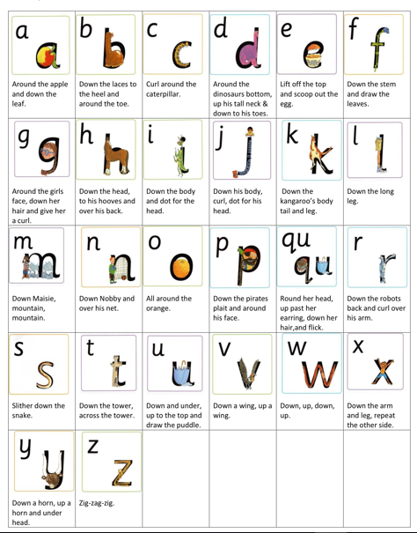
Handwriting Information
Please encourage your child to form their letters correctly from day 1. See below for the correct letter formation. This prevents the children from getting into ‘bad habits’ and then having to re-learn letter formation. Thank You!

