Slide 1



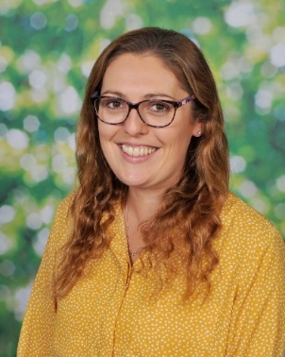
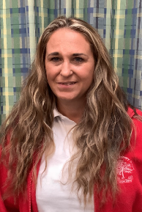
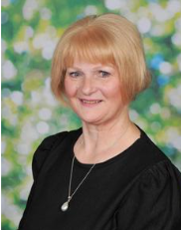
Welcome to
Puffins
Year 3 Class
2026-27
Your teachers are
Mrs Smith (Mon-Wed) and Mrs Firkins (Thurs and Fri)
The HLTA who will be supporting our class is:
Mrs Howell

Slide 2
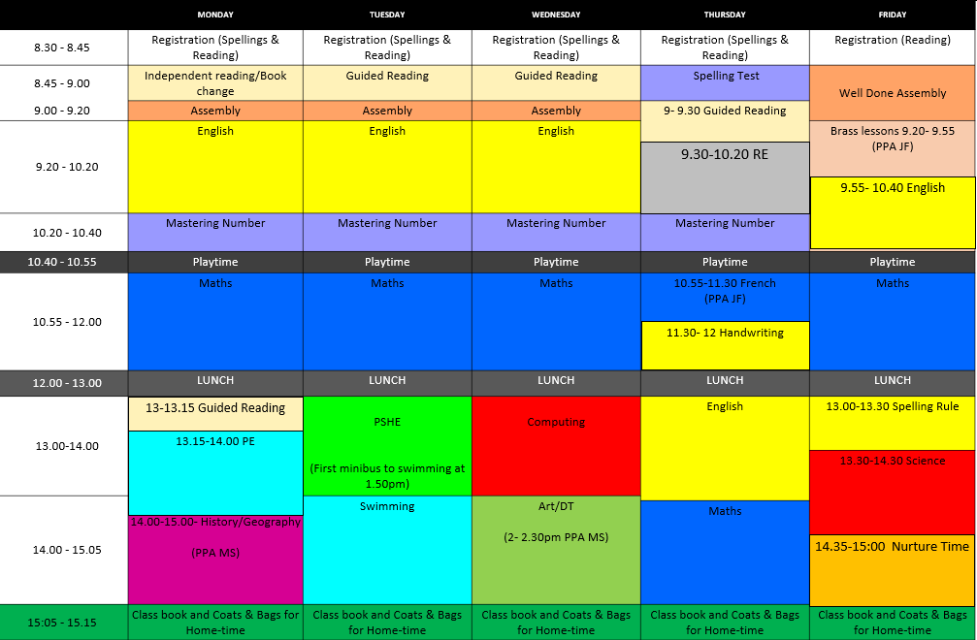
This booklet is to help provide useful information to parents and carers about our class routines so that you can help your child settle into their new class as smoothly as possible.
Class Weekly Timetable
Other Useful Information
P.E. (Kit needed) | Mondays are the class P.E. days during Autumn term. In the Autumn term, pupils will visit the leisure centre for swimming lessons on Tuesdays each week. Children are to come to school in their P.E. kits on both these days, to wear all day. On swimming days (Tuesdays), children will need to be collected from the leisure centre, unless they are booked in to Caterpillar Club.
Music | Music lessons are on Friday mornings. This year all pupils will have brass instrument tuition for their music lessons. Instruments will be allocated and taken home for practice. They then need to be brought in each week on this day (Friday).
Reading books | Children will be given a school reading book to be read at home and in school. Please send reading books in to school every day so that they can read to staff as required. Children can notify the teaching assistants when they need to change their book.
Reading Diary | Children will be sent home with a ‘Reading Diary’. The rear pages (working backwards from the rear cover) will be for the children and staff to keep a record of the titles of books they have read throughout the year. The front pages are for you to record when an adult listens to them read. Please listen to your child read several times a week, asking them questions about what they have read, and recording the pages read and any comments about their reading you wish to make. Weekly spelliing scores will also be recorded in their reading diary. Please keep the Reading Diary inside their current reading book so that it is coming in to school every day.
Homework | Homework will be a mixture of online tasks and paper tasks. Children are expected to read regularly, practise their spellings for a weekly test on Thursday and complete 15 minutes on TTRS. Depending on the week, it may be set through Seesaw or they may bring home paper sheets to be completed.

Slide 3
Home Learning Tasks
It is our school policy to provide the opportunity for children to undertake regular, age-appropriate activities at home that support and help to consolidate the children’s learning in school.
Research has shown that children make better progress in school when parents and carers are involved and interested in their child’s learning.
Suggested time per day | Approximately 10 - 15 minutes per night
Regular daily activities | • Reading to an adult. Please actively listen to your child read aloud as frequently as possible and ask them questions about what they have read. It is important to hear them read in this way (rather than letting them just read to themselves) as it means you can ensure they are understanding what they are reading and engaging with the text. It also builds a shared enjoyment of reading and promotes discussions around different topics. • Practise your weekly spellings each day. • Practise the times tables that your child is currently working on. ‘Times Tables Rockstars’ and ‘Hit the Button’ are very good for this. • Children should be able to recall these facts instantly out of sequence. • By the end of Year 4, pupils will be expected to be able to recall all times tables up to 12 x 12 with fluency, when they undertake the national Multiplication Tables Check.
Below is a list of websites that may be useful to use when practising your multiplication tables.
Times Tables Rockstars - https://play.ttrockstars.com/auth/school/student/40237/
Hit the Button - https://www.topmarks.co.uk/maths-games/hit-the-button
School Website
Please check out our class page on our school website. Here you can find websites for your information e.g. relating to English and Maths and lots of fun activities and games for you to play on with your child and they won’t even realise they are learning!
Here’s the address;
http://www.meadows.shropshire.sch.uk/welcome.asp
1. Go to children, then class pages.
2. Click on Puffins - Years 3
3. At the bottom of the page are links to online resources and activities to support their learning.

Slide 4
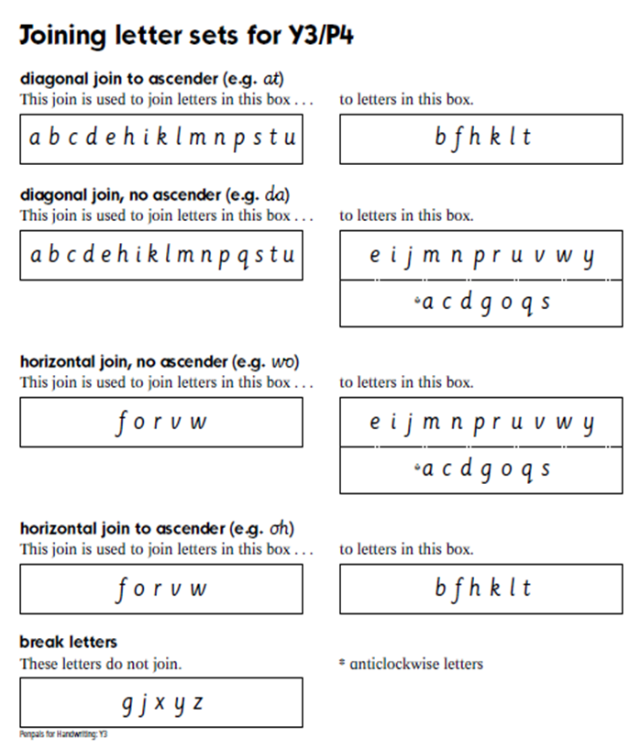
Handwriting Information
Please encourage your child to form their letters correctly as early as possible. See below for the correct letter formation. This prevents the children from getting into ‘bad habits’ and then having to re-learn letter formation. Thank You!

Slide 5
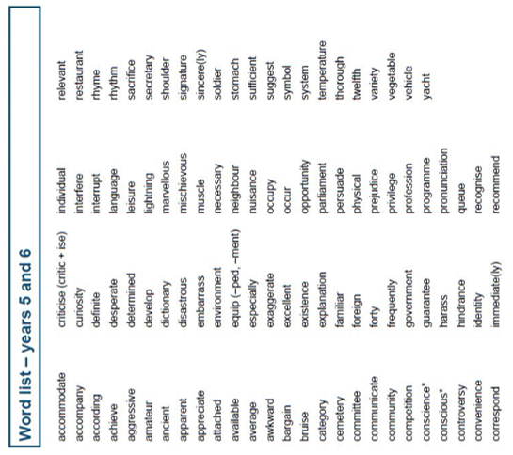
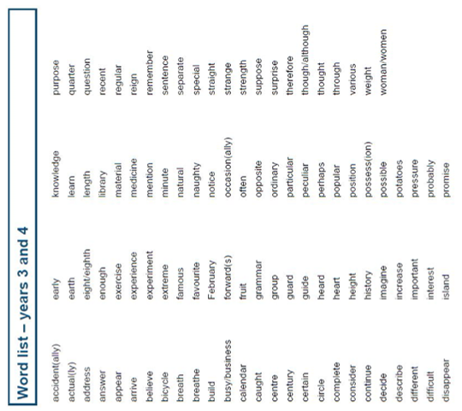
The children do not need to know the Year 5 & 6 words yet, but some parents might find them useful for if your child fancies a challenge!
Below is a copy of the word-list for years 3/4 and 5/6 which is a statutory requirement in the National Curriculum. The lists are a mixture of words pupils frequently use in their writing and those which they often misspell. Some of the listed words may be thought of as quite challenging. However they are learnt over time and we work on them regularly as part of our weekly spelling tests. It would be helpful if you are aware of these words and could work on them together at home.
Spelling Expectations

Slide 6




Times tables information
In the table below are the National Curriculum times tables expectations for each year group. The children will be tested on their times tables regularly in school. Children will also be expected to know any previous year groups multiplication tables.
In June, Year 4 pupils will take the National Multiplication Tables Check (MTC). Children are given a few seconds to respond to a series of multiplication questions up to 12 x 12. More details about this will be shared closer to the time.
Year 1 | Count in multiples of 2, 5 and 10. Recall and use all the doubles to 10 and their corresponding halves.
Year 2 | Recall and use multiplication and division facts for the 2, 5 and 10 multiplication tables, including recognising odd and even numbers.
Year 3 | Recall and use multiplication and division facts for the 2, 4, and 8 multiplication tables.
Year 4 | Recall and use multiplication and division facts for up to 12 x 12.
Year 5 | Revision of all multiplication and division facts up to 12 x 12.
Year 6 | Revision of all multiplication and division facts up to 12 x 12.
At the Meadows Primary School, we want to encourage and support your child to fluently recall their times tables up to 12, which is essential for future success in mathematics. Knowledge of multiplication and division and its applications forms an important aspect of the KS2 curriculum, and is the gateway to success at secondary school.
To encourage and recognise the hard work children put into learning their multiplication facts, we have a multiplication reward badge system. The reward badge system has 4 levels. To earn a badge, children will need to have completed the relevant times table on TTRS and their heat map will be green.
Bronze: 2, 5 ,10 multiplication facts
Silver: 4, 8 multiplication facts
Gold: 3, 6, 9 multiplication facts
Ultimate: 7, 11, 12 multiplication facts
Once the multiplication facts for each award have been achieved, your child will bring home a slip for you to request the purchase of the badge. If you wish to purchase the badge, each one will cost £1.00. Upon return of the slip to school, the badge request will be added to Eduspot where you will be able to complete the purchase. The badges will be presented to the children in Well Done assembly on a Friday and can be worn on the collar of their school T-shirt.

